Slide 1

Graph Theory Project
Garnier Aurélien
Mazardin Grégoire
Royer Médéric

Slide 2

Summary
Structure of the code
Format of the files
Filling the graph
Detecting cycles and calculating ranks
Scheduling or not
Display
Encountered difficulties

Slide 3
Structure of the code

Slide 4
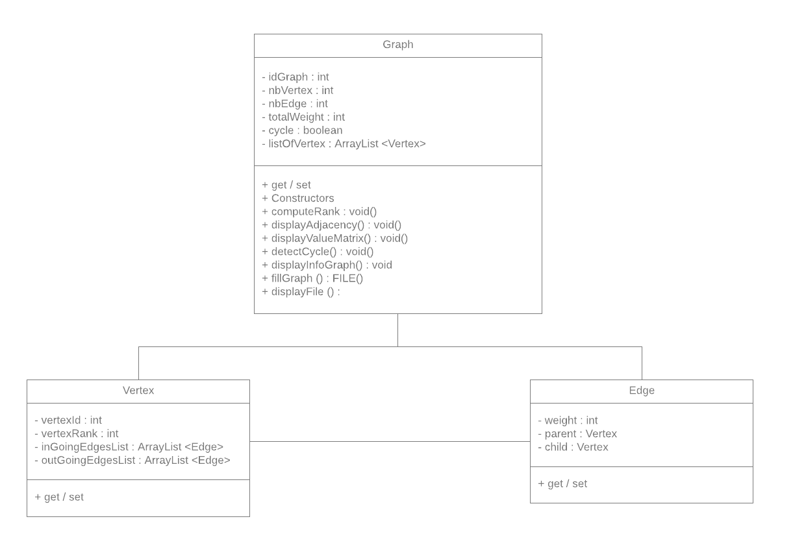
Class Diagram

Slide 5

Format of the files
Number of vertices
Number of edges
Relationship between vertices and their weight

Slide 6
Our methods

Slide 7
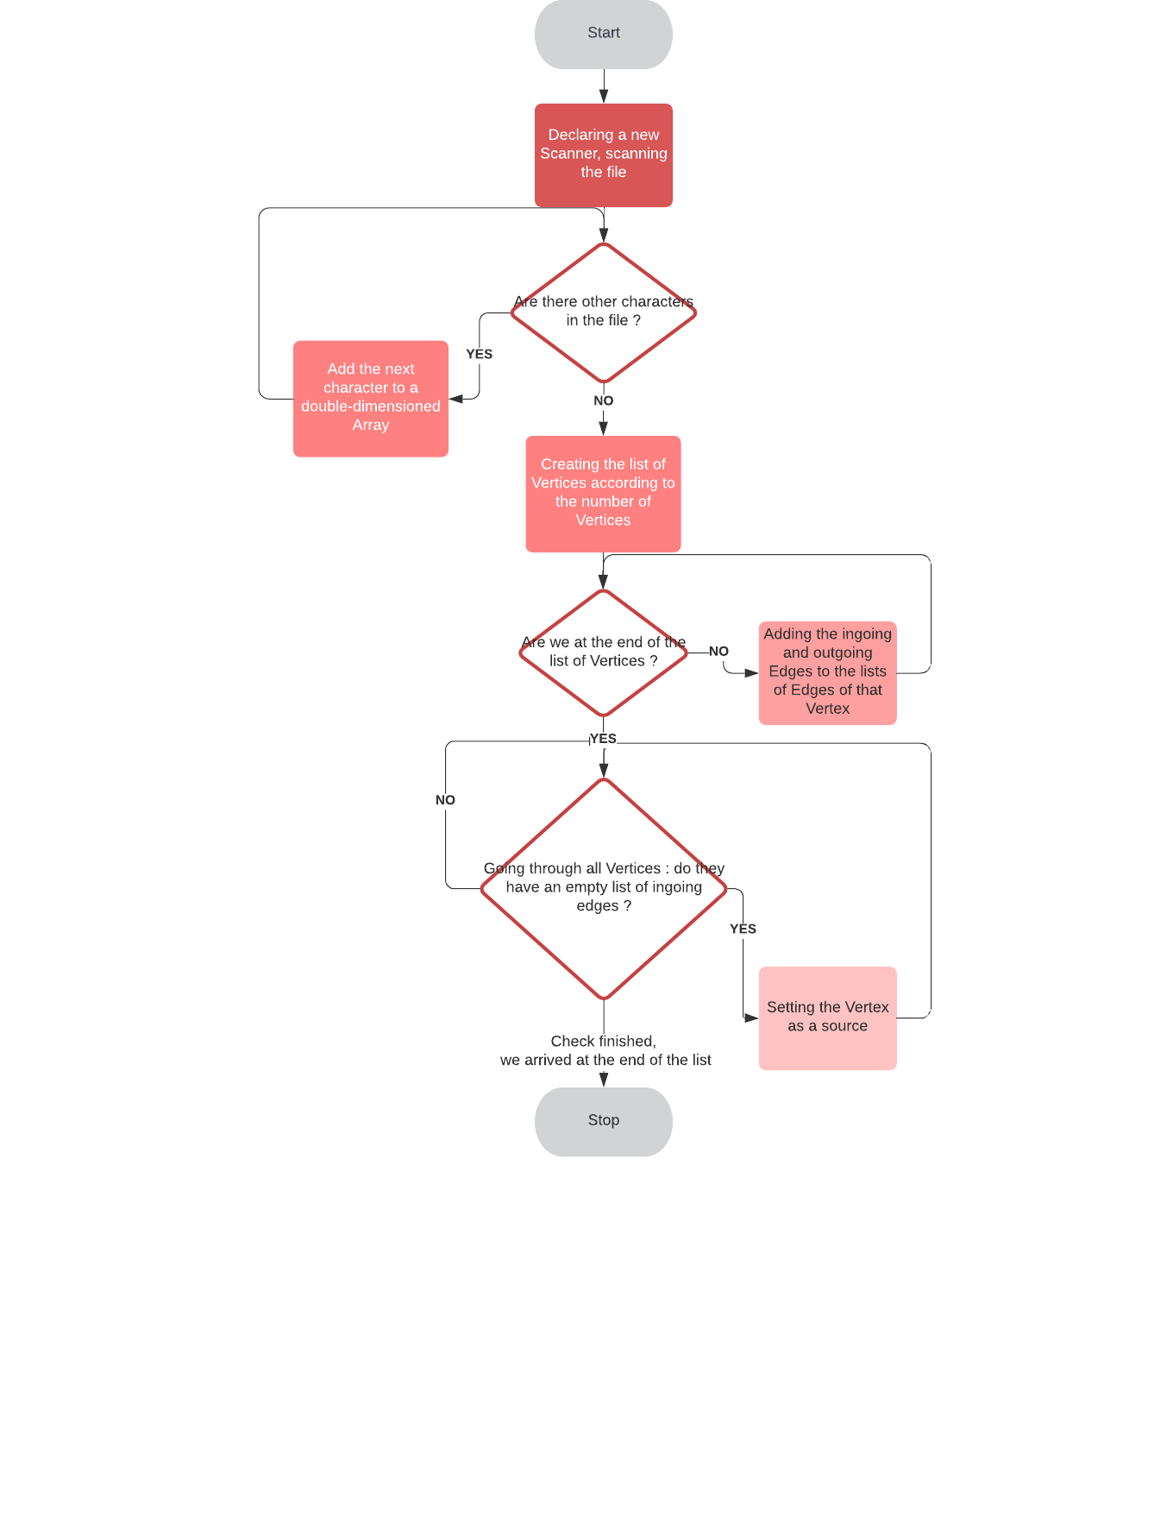
Filling the graph

Slide 8
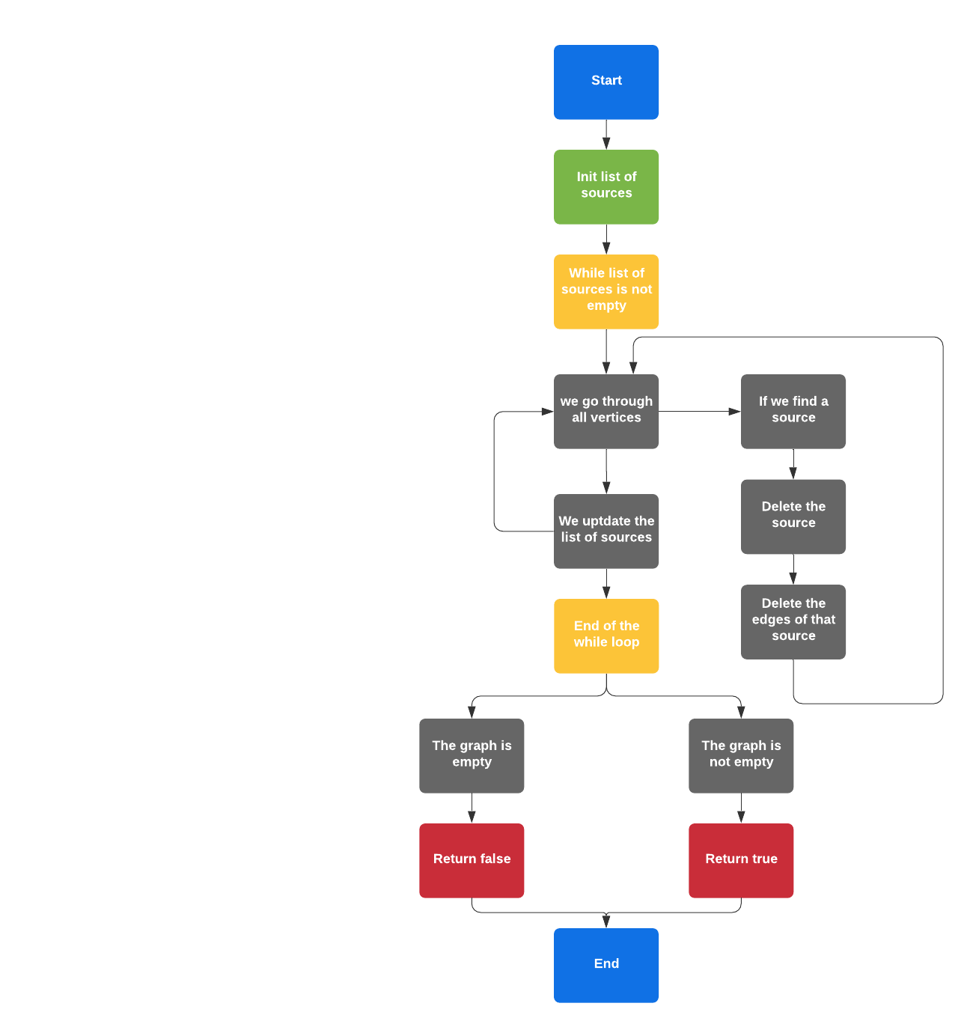
Detecting cycles and calculating ranks

Slide 9
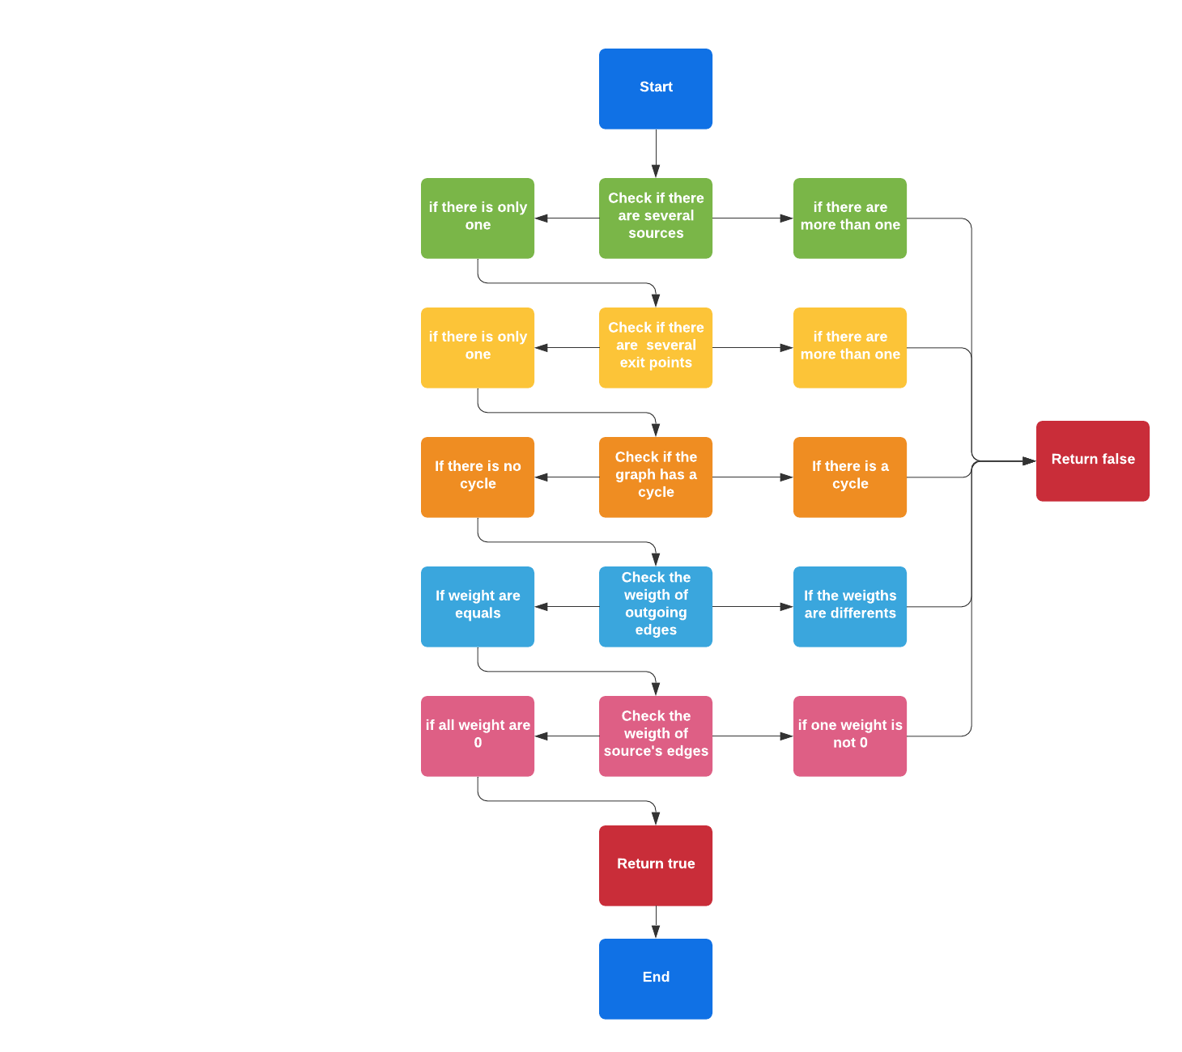
Scheduling or not

Slide 10
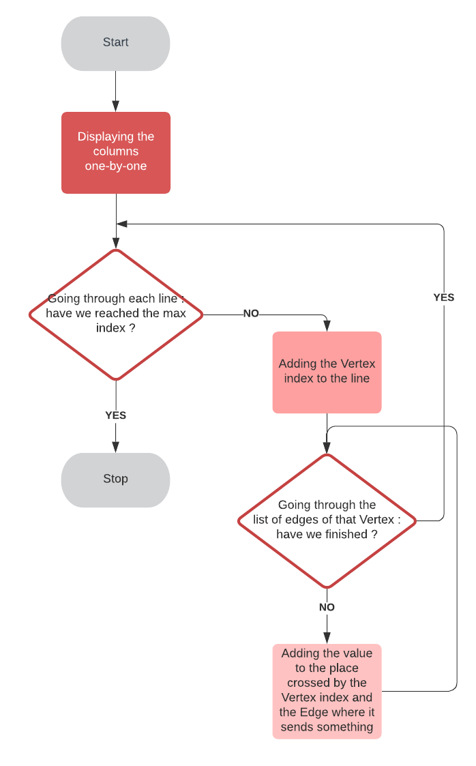
Display Value Matrix and Adjacency Matrix

Slide 11
Encountered problems
Shortests paths : Difficulties to program Bellman's algorithm
Git hub : Not easy to manage the same code with three people
Thinking the global structure of the code (classes, relations between each other, etc.)

